Slide 1

Sales Dashboard Analysis
Uncovering actionable insights from sample sales data to drive strategic business decisions and optimize performance across regions, products, and sales teams.

Slide 2

Project Overview
Data Source
Objective
Methodology
Kaggle Sample Sales Data providing comprehensive transaction records across multiple regions and product categories.
Analyze sales trends, identify customer patterns, and evaluate regional performance to inform strategic decision-making.
Data visualization through interactive dashboard insights, focusing on key performance indicators and trend analysis.

Slide 3

Dataset Structure & Scope
Core Data Fields
Geographic Coverage
Transaction Records
OrderDate, Region, Rep, Item, Units, UnitPrice, and Total revenue tracking comprehensive transaction details.
Multi-regional sales data spanning diverse markets, enabling comparative performance analysis across territories.
Each row represents individual sales orders, creating granular visibility into customer purchasing behavior and patterns.

Slide 4
Key Metrics / KPIs
• Average Sales per Order
• Highest Selling Item
• Total Sales
• Best Performing Region
• Top Sales Representatives

Slide 5
Dashboard Visualization Components
• Sales Trend over Time
• Regional Sales Distribution
• Sales by Product/Item
• Top 5 Sales Representatives
• Units Sold vs Revenue

Slide 6
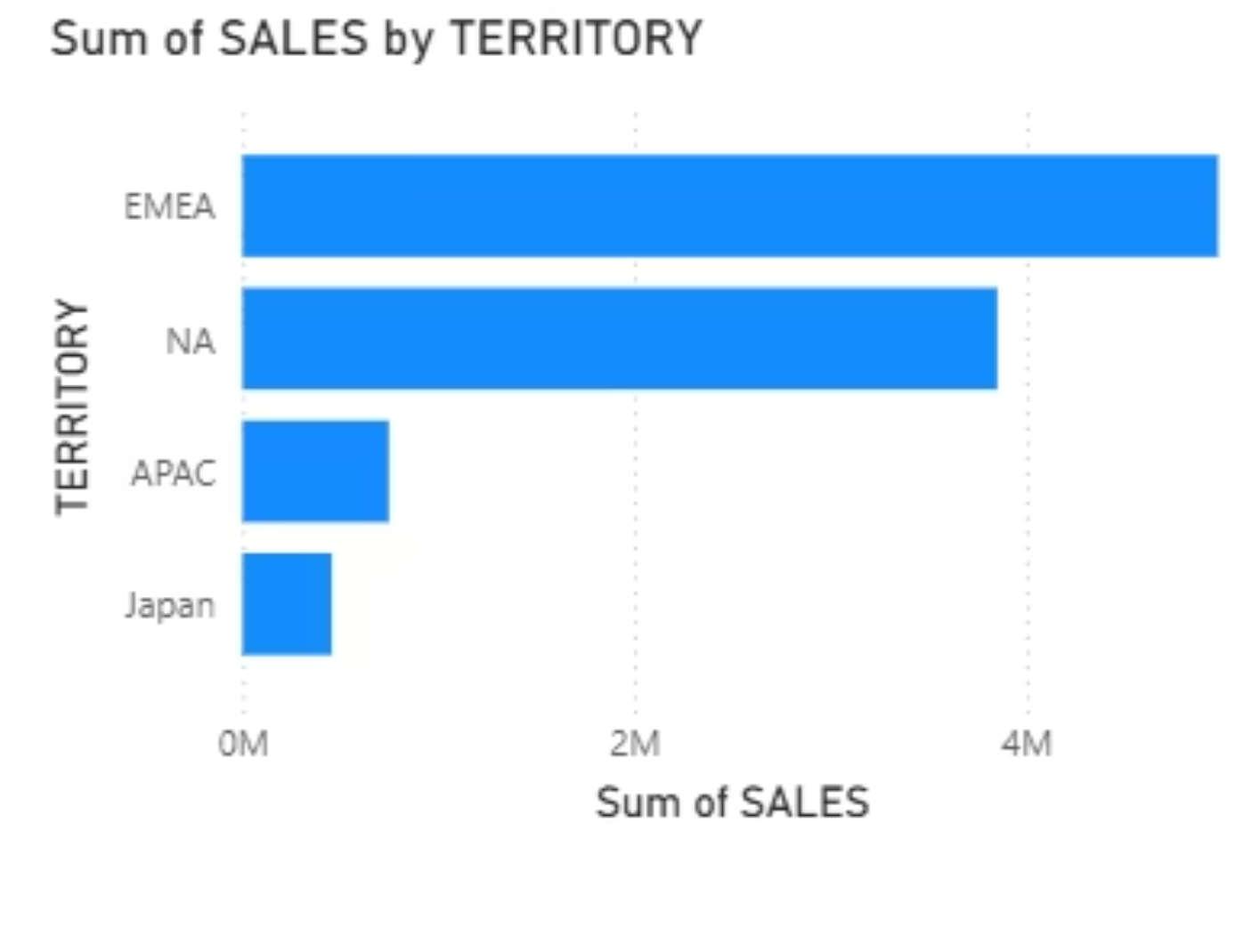
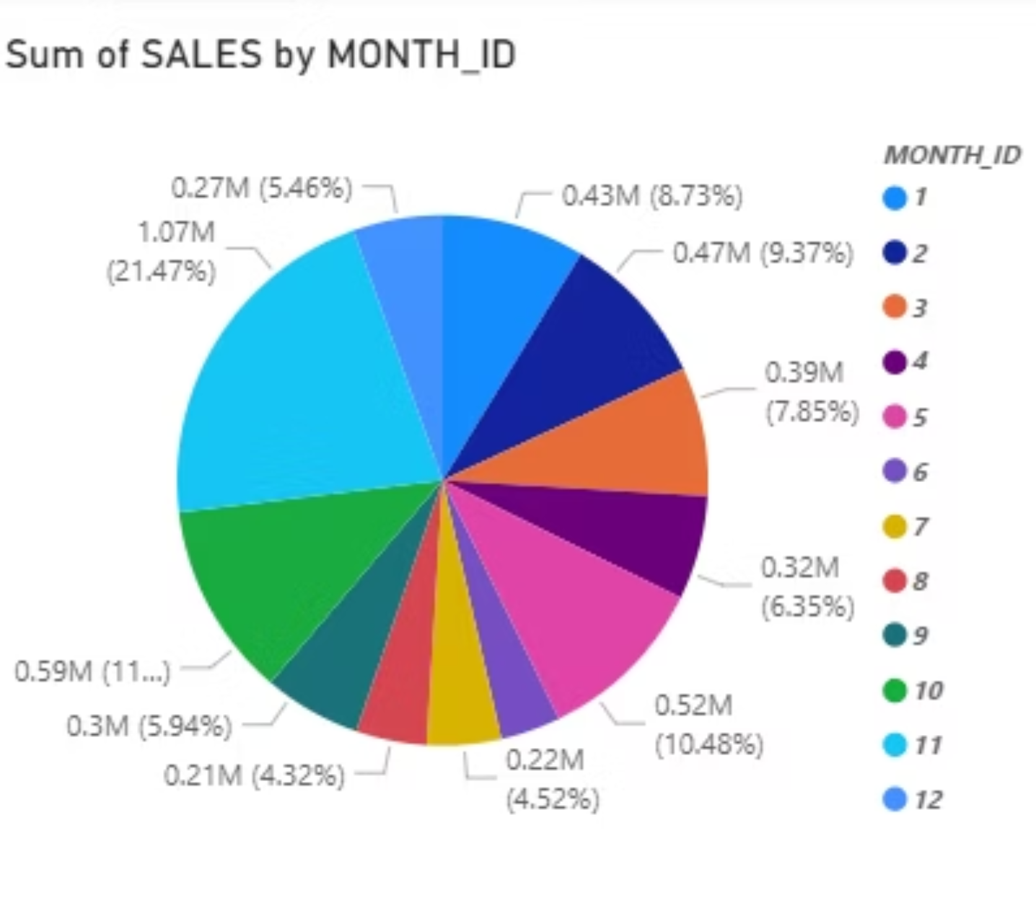
Dashboard Visualizations
Sales trend analysis showing consistent growth patterns with notable seasonal variations and regional performance differences.
Regional distribution breakdown highlighting market penetration levels and identifying expansion opportunities in underperforming areas.

Slide 7
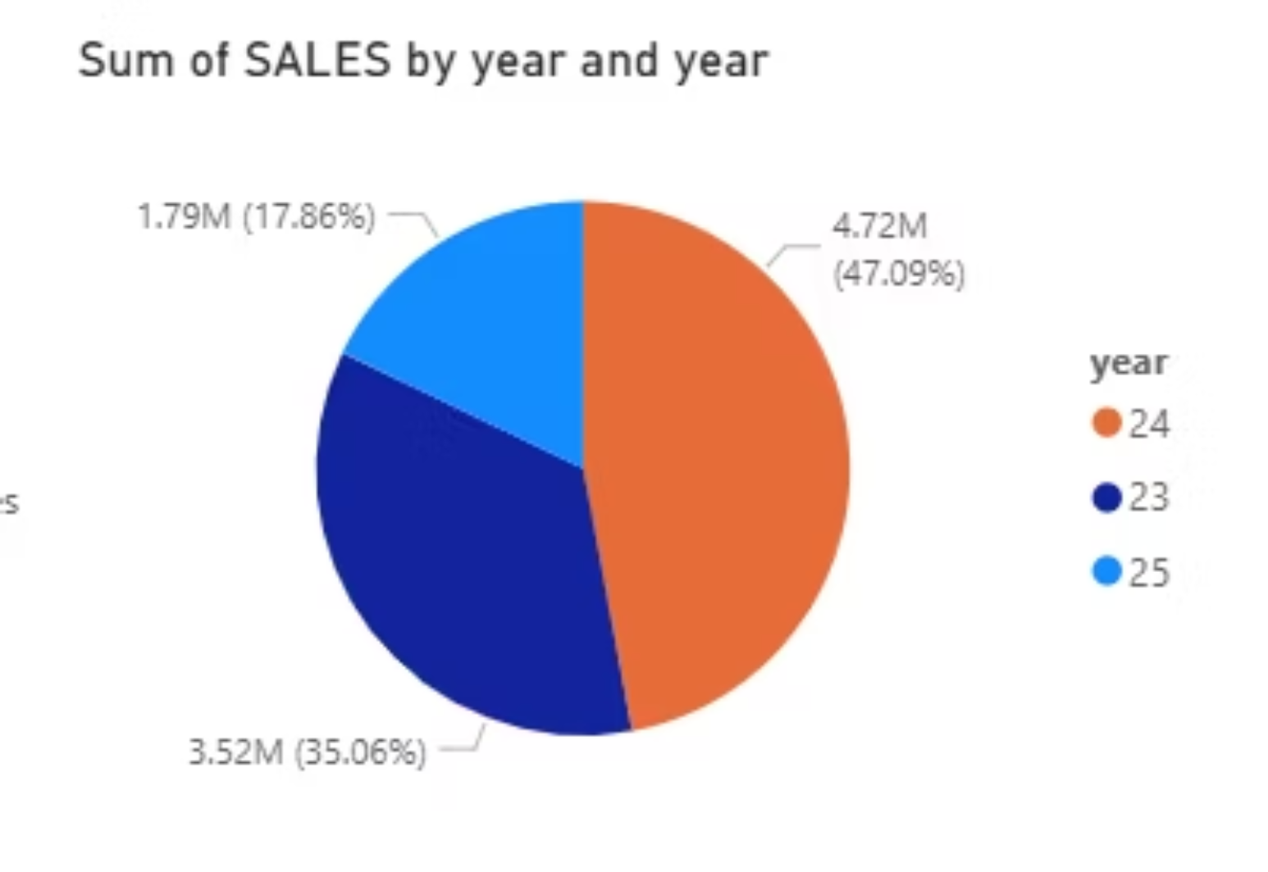
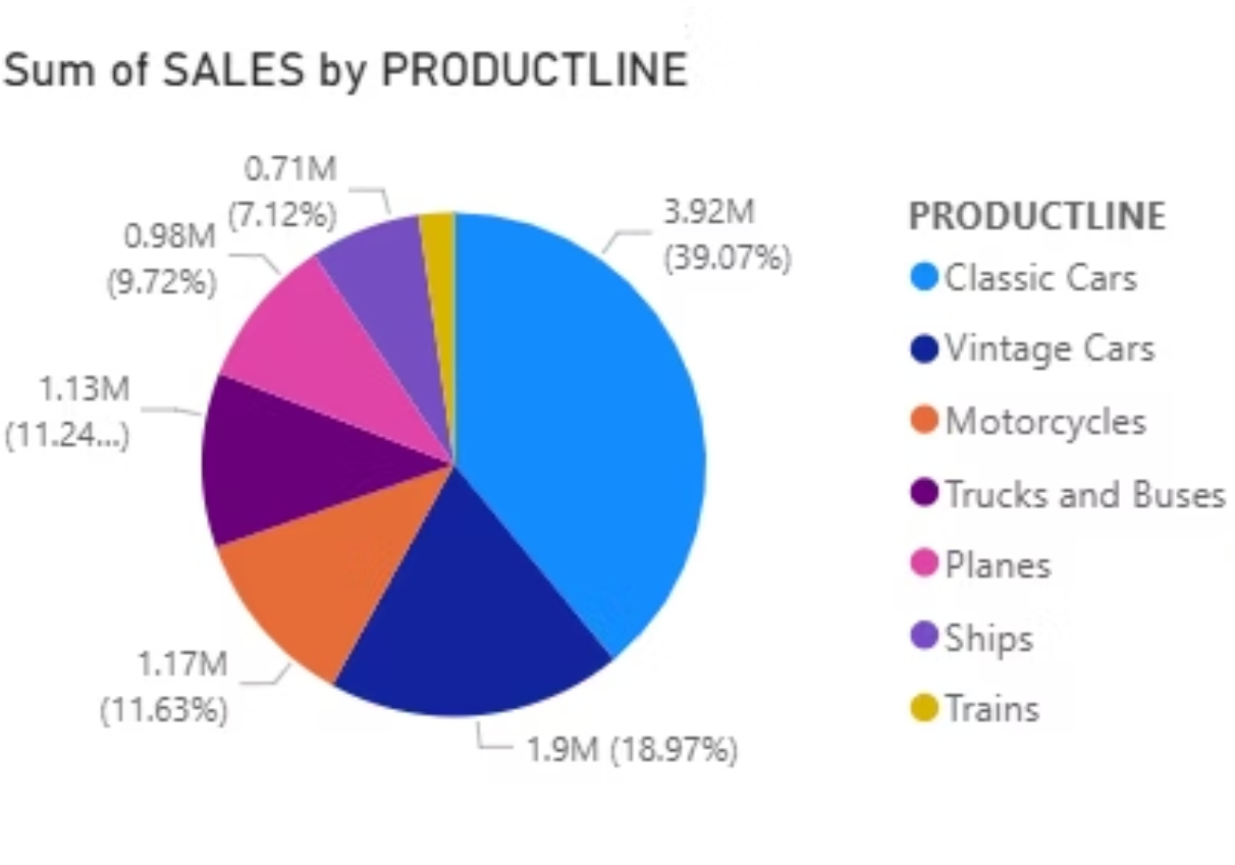
Product performance analysis revealing top-selling items and category-level revenue contributions for strategic inventory planning.
Sales representative performance metrics showcasing individual achievements and team development opportunities for enhanced productivity.

